Slide 1
CyberFocus Pitch
Calum Murray, Pawel Kozubal, Brodie Templeton, Samuel Yerokun

Slide 2
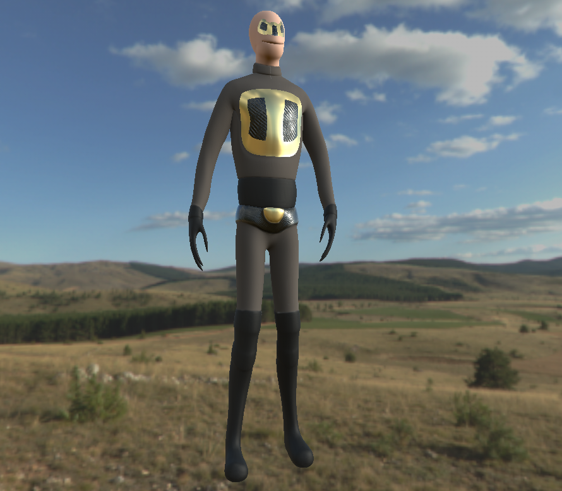
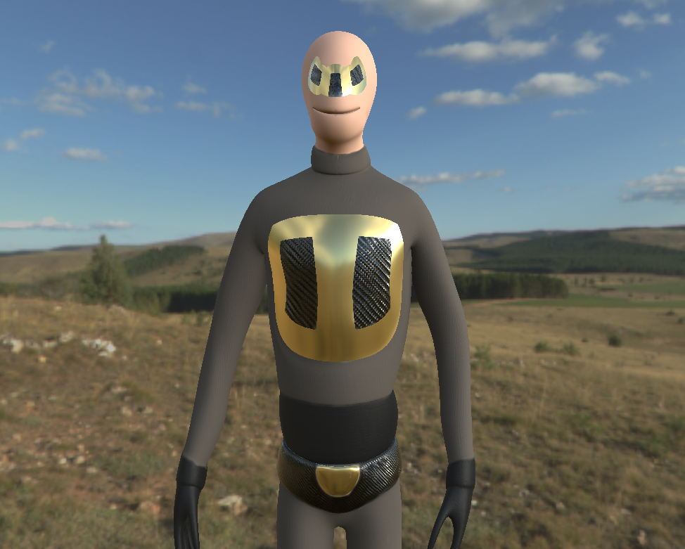
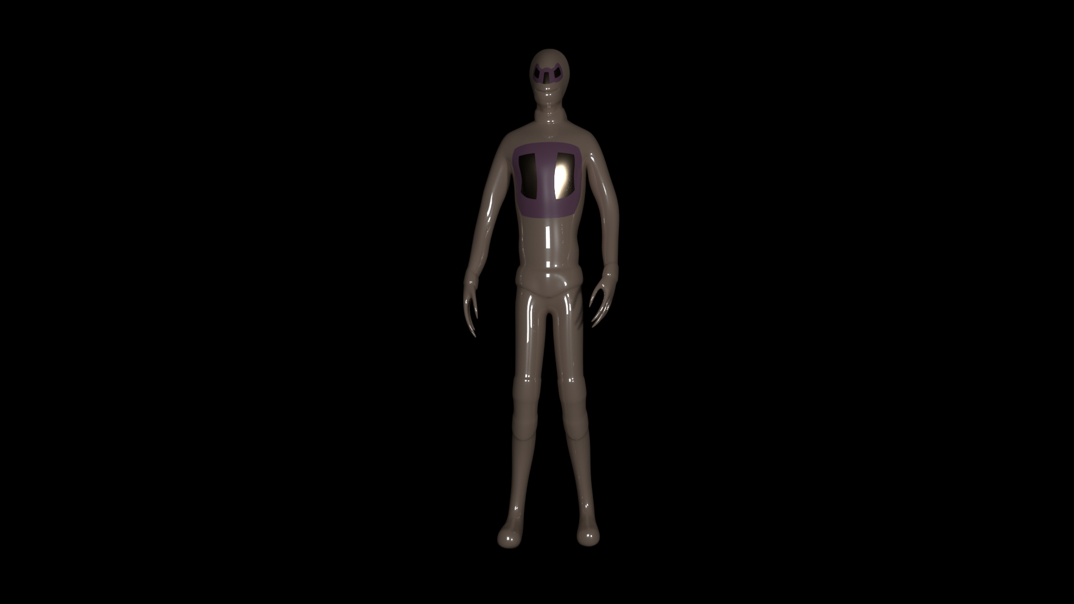
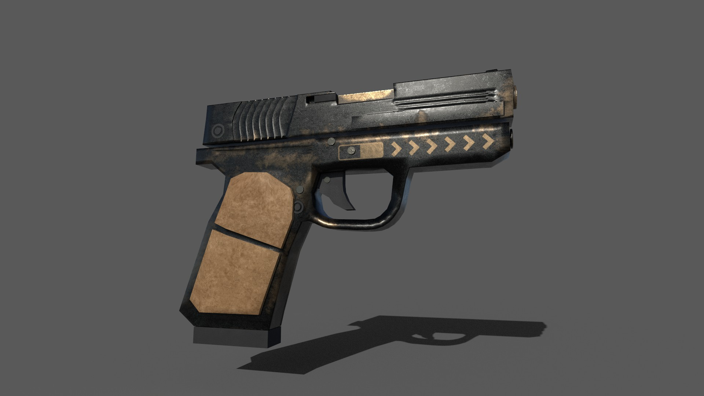
What is it?
“CyberFocus is a first person shooter (FPS) set in the future where players can bend time and parkour to outsmart their enemies in fun and unique ways.”
We aim to make it unique with a blend of parkour and slow motion game mechanics
By incorporating these, we believe that this creates a fun and engaging game.
Notes:
This slide will discuss the

Slide 3
Why does it make sense?
For the mechanics to make sense to the player, we wanted to make sure there was a backstory behind it.
Set in the future, players will be in the shoes of a cyborg, capable of being able to traverse levels and slow down time.
In order for players to understand the game, we will be working from a 3 phase model.
Notes:
3 phase model is the progression we will want player to follow to understand the game better.

Slide 4
3 phase model
Phase 1 – Understanding the game.
Phase 2 – Test the players understanding of the game by placing a challenge in front of them.
Phase 3 – Ensure player understands the game by having them complete the most challenging part of the level but by also making it still feel fun and engaging.
Notes:
Phase 1 is the introduction phase (introduce them to the mechanics, the story etc).
Phase 2 is the challenge stage (once players understand the game better, place a challenge in front of them and make them overcome it themselves to prove they understand it)
Phase 3 is the final stage where players utilise all they have learned in the final part of the level and ensure it is creative enough so it is fun and feel new.

Slide 5
Why is is it fun?
We believe CyberFocus will excite players by giving them the ability to take on encounters in fun and engaging ways.
With the ability to wall run, slow down time, parkour and shoot, players can be creative with how they want to take on enemies and manoeuvre levels.

Slide 6
Why would someone want to play it?
As it is a first person shooter, most players will feel comfortable with the controls layout as FPS are mainstream in the current gaming world. This would then attract them to play and
We feel the game would be appealing as having a mix of gunplay with parkour and slow motion would be fun and players, may find a similarity to games such as Mirrors Edge.

Slide 7
Innovation
Teams should be able to demonstrate why it is innovative and creative by having a solid grasp of the market / genre of their prototype, backing up their claims with tangible evidence from playtesting, engaging with a wider audience and feedback.
Consider:
• What is already out in the market?
• What is missing from the market?
• How your games’ innovation will fill the gap and meet the need?
Already on the market: Mirrors edge, Titanfall – both very popular, mainly due to the parkour mechanics mixed with gun play.
What is missing from the market: Not had a memorable parkour fps since Titanfall, so with CyberFocus we can bring back interest by promoting this on the market and grab the attention from possible players
The games innovation will fill the gap by bringing familiar mechanics to the fps genre but mixed with new fun and engaging mechanics that players will find new and want to experiment with.

Slide 8
Company development team
You should provide high level information about your team (it should be concise and relevant). Draw on key skill sets and experience that complement and enhance your prototype offering. Information shared should instil confidence that your team can deliver the prototype development plan on time, to budget and to a high standard.
Brodie – programmer proficient in C#, attended gamejams (experience working in teams an sticking to deadlines) and always open to feedback.
Pawel – Comfortable with the Unity engine, Experience creating levels (worked alongside him on various projects)
Samuel – 3D Modeller, experience collaborating with different teams (games and animation students), experienced in environment modelling

Slide 9
Shipping
Clear understanding of:
• Platforms for shipping the finished game
• Go-to-market plan
o Route to market: self-publish / publisher / other route with robust plan and understanding of how they will successfully deliver their game and realise projected revenue
o Revenue model for example F2P, Premium, Subscription, and/or DLC plans
Ship to PC first then release for console. Provide controller support for PC.
Market plan: Self-publish: we have planned the deadline for the game March next year. It is important to ensure the game is fitted well for PC and working on console which means changing controls and UI elements as well as graphics to enhance performance.
In order to ensure the game releases by the end of the year, we have had to review aspects of the game that we thought would need top be removed such as multiplayer for now which saves us 2/3 months of work.
We will get an accountant to not haver to run into problems with tax etc.
Once we have a beta, we intent to build a community from scratch. Using sites such as reddit and twitter but we must also make sure we know the reddit communities we are posting to first before just posting onto a page. We will use twitter as our dev diary for updates.
In order to build excitement for the game we have decided to use “Screenshot Saturday” as a way of keeping people updated with the game. For example, any new art or game feature we have developed will be featured on screenshot Saturday.
Press outreach and PR: maybe hire a contractor to do PR
Coming up with a tight elevator pitch
Can use youtubers to advertise our game in a way screenshots or text cant. It is also a great way for testing and finding new bugs or ways people play the game
Revenue model: We intend to fully release the game onto Steam by the release deadline. We feel this is right because we will have a Patreon page as a source of income during the project. Using this allows us to have specific tiers give specific users benefits who subscribe and help the development of the game. it will also allow us to also add DLCs to the game to keep players invested and spread their enjoyment of the game to bring in more potential users.

Slide 10
Commercial sustainability
Be able to demonstrate that you plan to create and grow a sustainable studio post-competition.
• Expert knowledge of the business and the project and be able to talk at ease about all aspects.
• Financial / Commercial
o Clear understanding of sources of finance, where you will generate income both whilst in this development phase and afterwards - i.e. other funders, publishers, selling assets etc. Think about life beyond the possible UK Games Fund grant fund.
o Demonstrate that your budget and projected costs are realistic and in-line with publisher’s project budgets.
• Impact
o What would the impact of securing the UK Games Fund support have on your team / company?
o Are there other impacts that are not purely commercial?

